Slide 1

" Social Buzz Company - Data Analysis & Visualization”
Accenture: Data-Analytics Virtual-Internship Task 2 & Task 3
Made By: Dhyey Joshi

Slide 2
Made By: Dhyey Joshi Supervisor : Mr. MARCUS ROMPTON Branch : CSE

Slide 3
Introduction
1
Analysis Of Our Project Title

Slide 4
Abstract
Social Buzz is a fast growing technology unicorn that need to adapt quickly to it's global scale. Accenture has begun a 3 month POC focusing on these tasks:
An audit of Social Buzz's big data practice
Recommendations for a successful IPO
Analysis to find Social Buzz's top 5 most popular categories of content

Slide 5
Proposed System
The whole Visualization was completed in 2 steps
a. Creating a dataset from multiple data source.
b. Creating a main dataset and divide into two parts one for 2020 per day , 2021 per day so that we can get time series dataset to perform data analysis of Social Buzz Client Reaction & analysis of sentiment for their application.

Slide 6
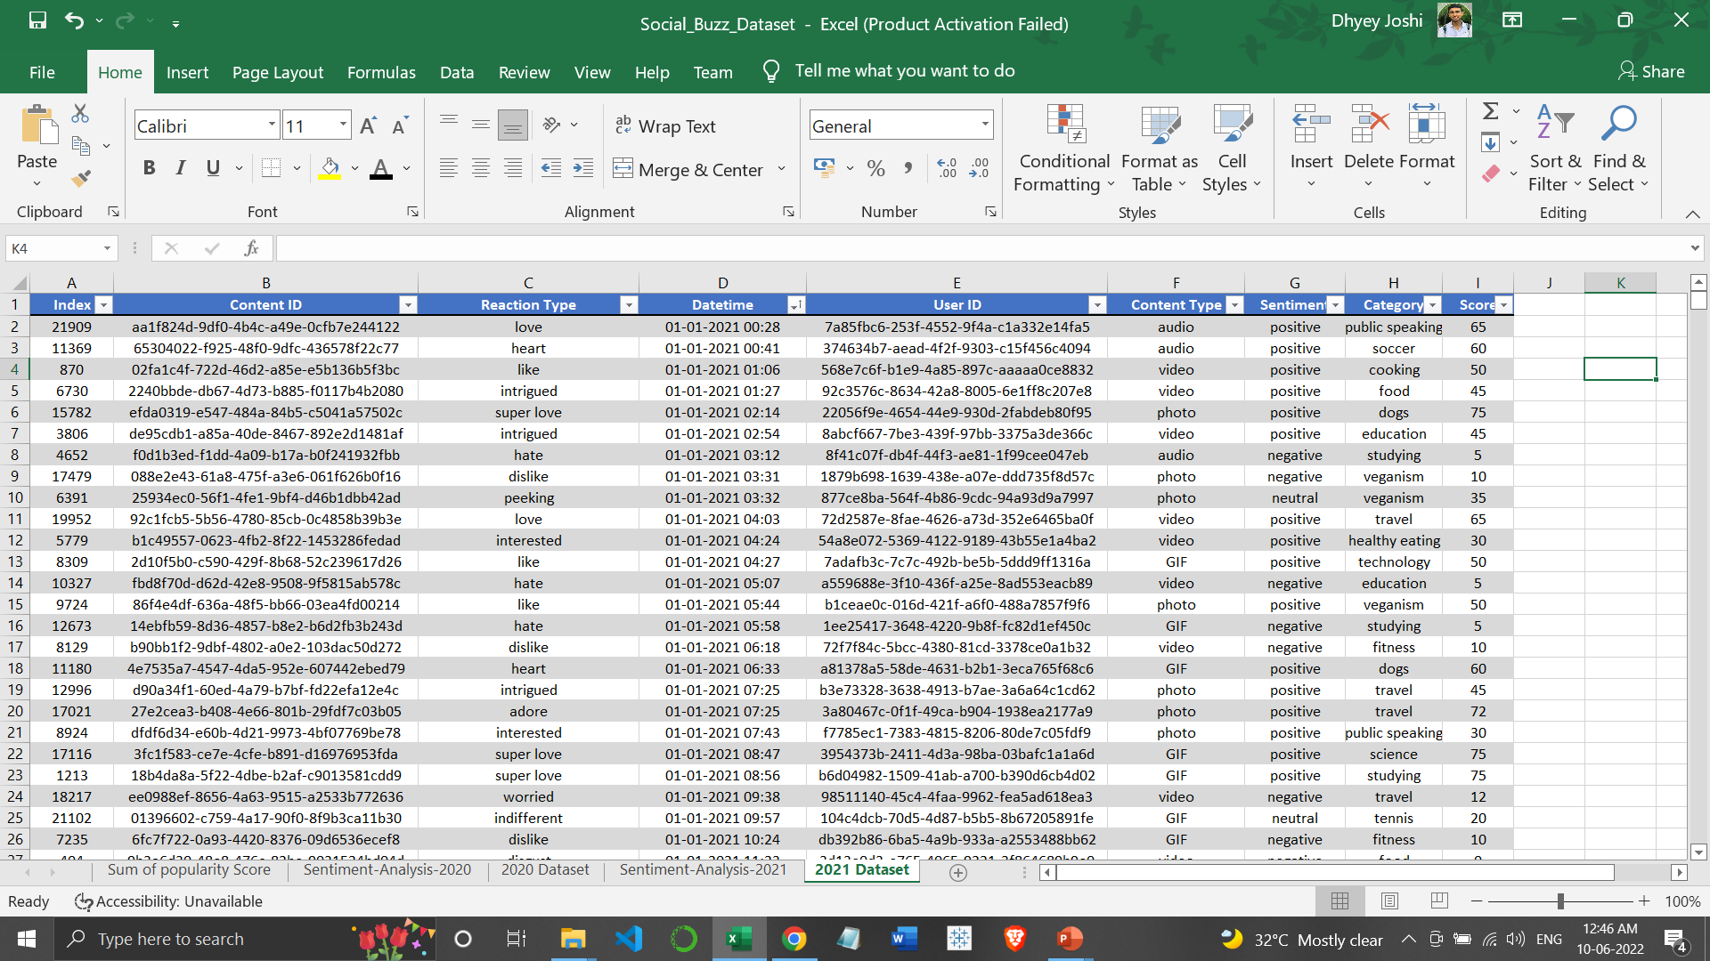
Dataset description

Slide 7
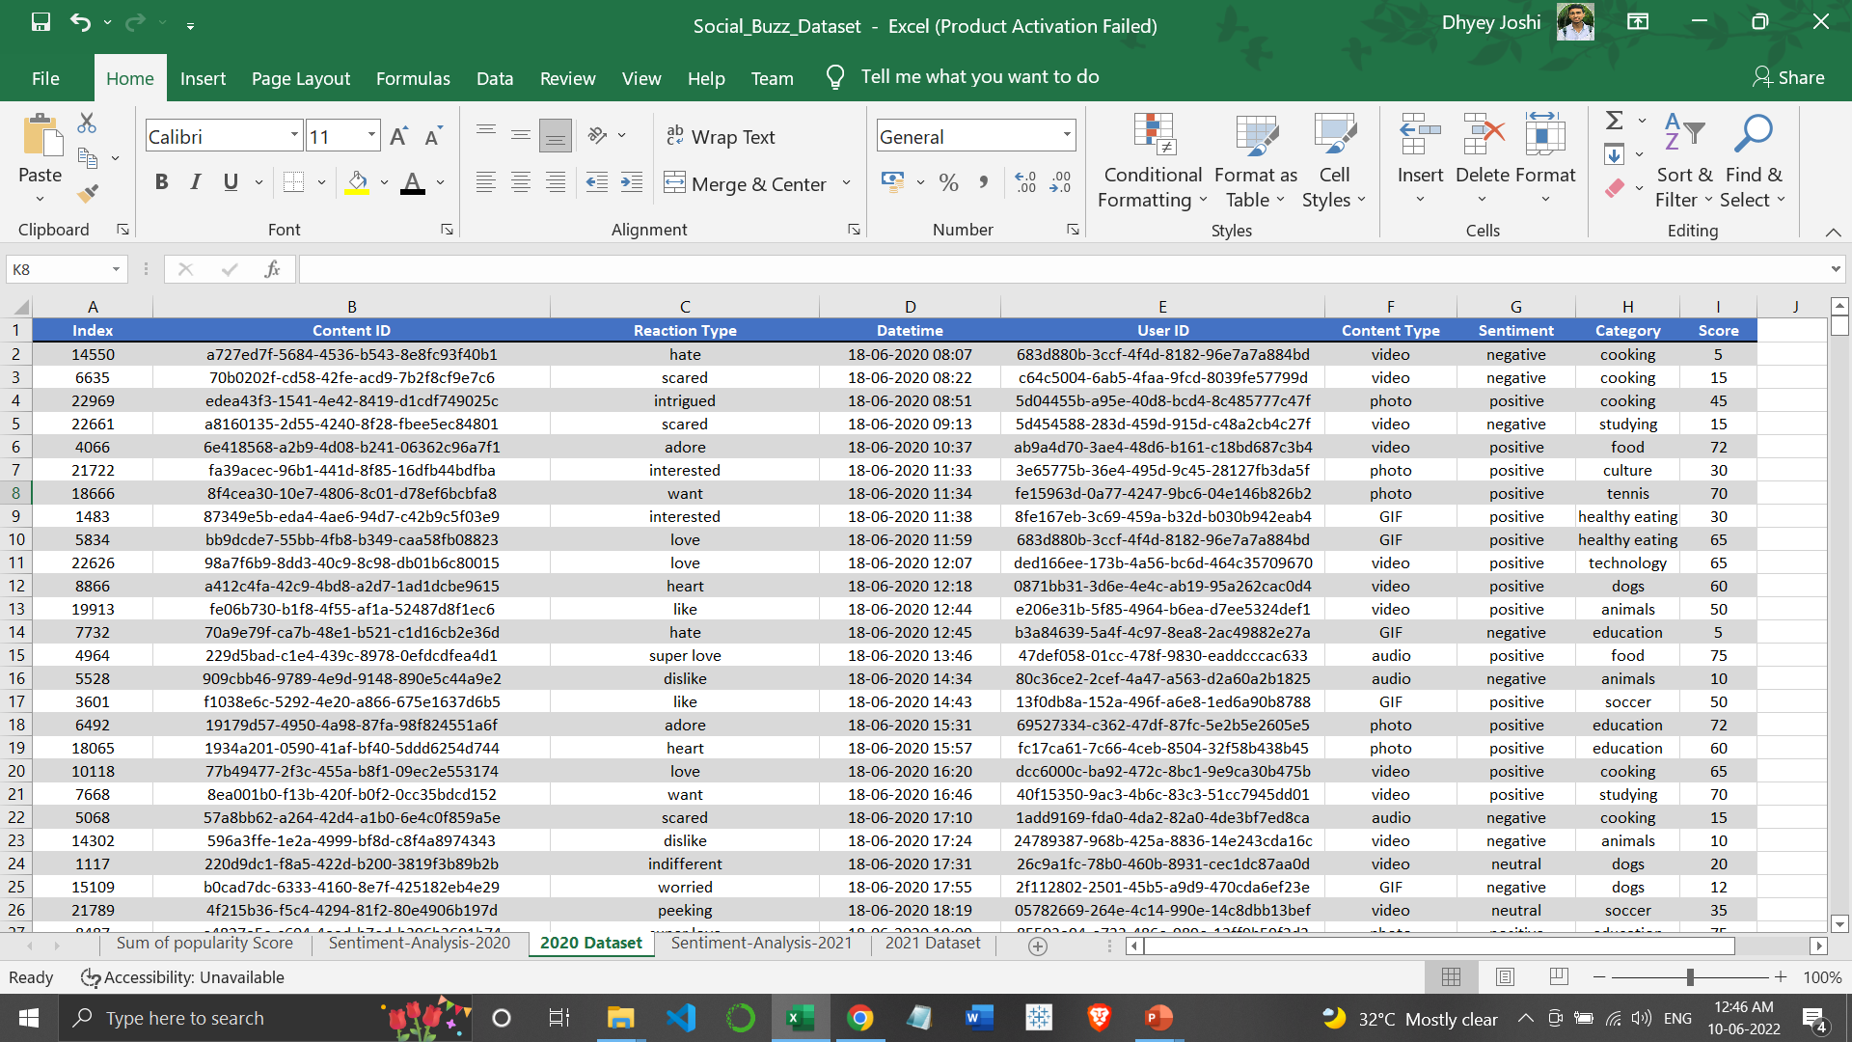

Slide 8

Problem
Over 100000 posts per day.
36,500,000 pieces of content per year!
But how to capitalize on it when there is so much?
Analysis to find Social Buzz's top most popular categories of content –Rank Wise

Slide 9




Dhyey Joshi
Data Analyst
THE
ANALYTICS
TEAM
MARCUS ROMPTON
Senior Principal
ANDREW FLEMING
Chief Technology Architect
Notes:
Talking about experience, we have a large data analytics practice at Accenture but we had a team of 3 people primarily focusing on this task. Andrew Fleming is our Chief Technical Architect and his expertise really helped to guide the team to produce high quality analysis.
Marcus Rompton, a senior principal has worked with the worlds biggest clients on solving their data problems and was heavily involved in the data engineering side of this project.
And finally myself, [NAME], who was solely responsible for taking leadership guidance and delivering high quality insights from the raw datasets and turning these into business decisions.

Slide 10

Overall Workflow
Data Gathering
Data Pre-Processing
Standardization
Data Visualization
(Uncover Insights)
Feature Engineering
Data Cleaning
Data Analysis
Data Modeling
Exploratory Data Analysis
Dataset ready for model building

Slide 11
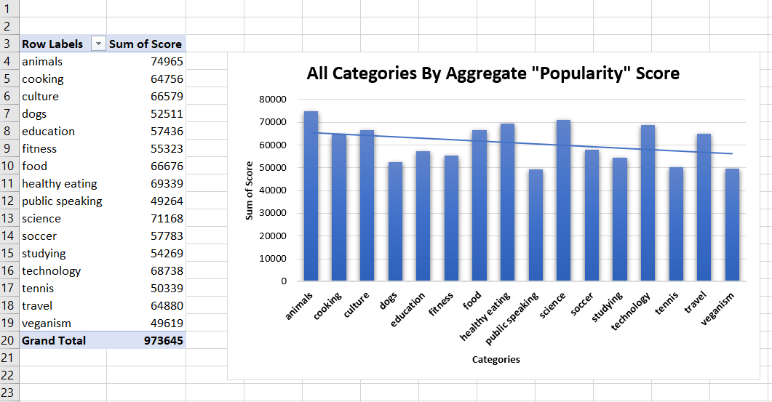
Result And Analysis

Slide 13
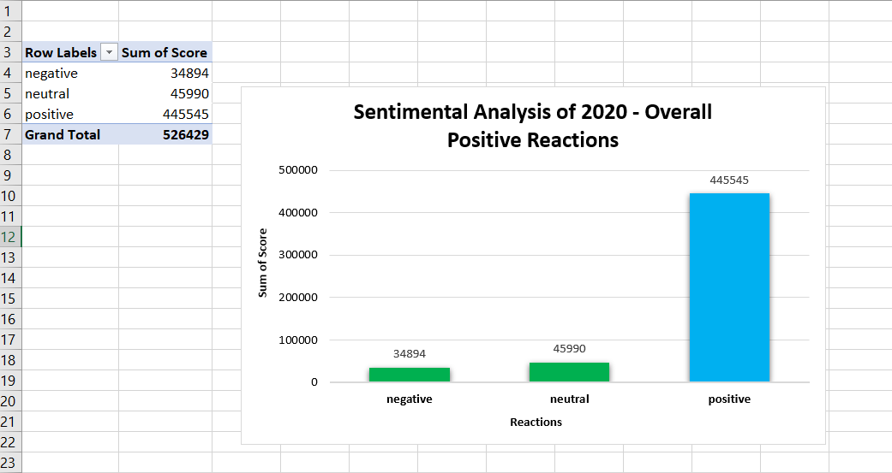

Slide 14
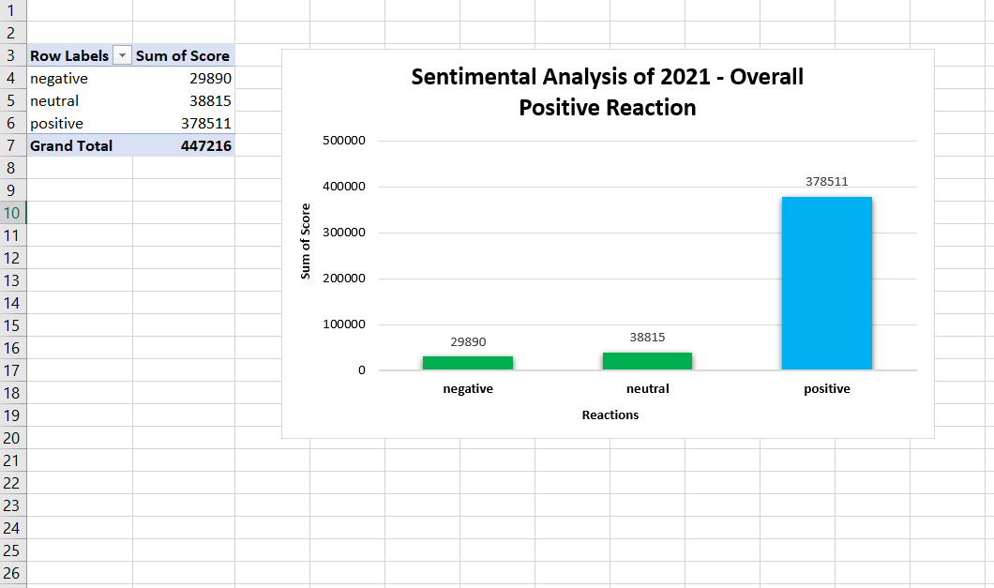

Slide 17
Summary
ANALYSIS
Animals and science are the two most popular categories of content, showing that people enjoy "real-life" and "factual" content the most.
INSIGHT
Food is a common theme with the top 5 categories with "Healthy Eating" ranking the highest. This may give an indication to the audience within your user base. You could use this insight to create a campaign and work with healthy eating brands to boost user engagement.
NEXT STEPS
This ad-hoc analysis is insightful, but it's time to take this analysis into large scale production for real-time understanding of your business. We can show you how to do this.

Slide 18
Thanks!
Any questions?
You can find us at:
Email: dhyey1974@gmail.com
Linkedin:https://www.linkedin.com/in/dhyey-joshi12/
Made By: Dhyey Joshi

